Slide 1
Final Project Conjugate Gradient Poisson Solver
R08222060 物理碩二 陳琦畯
40544019S 地科大五 林迺芥

Slide 2
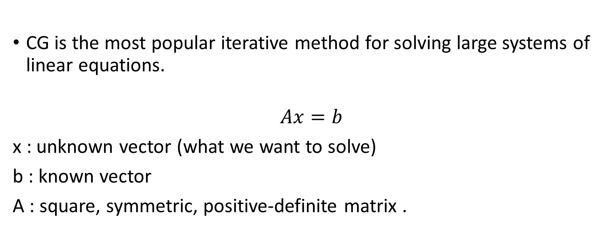
Introduction
CG is the most popular iterative method for solving large systems of linear equations.
$$Ax=b$$
x : unknown vector (what we want to solve)
b : known vector
A : square, symmetric, positive-definite matrix .

Slide 3
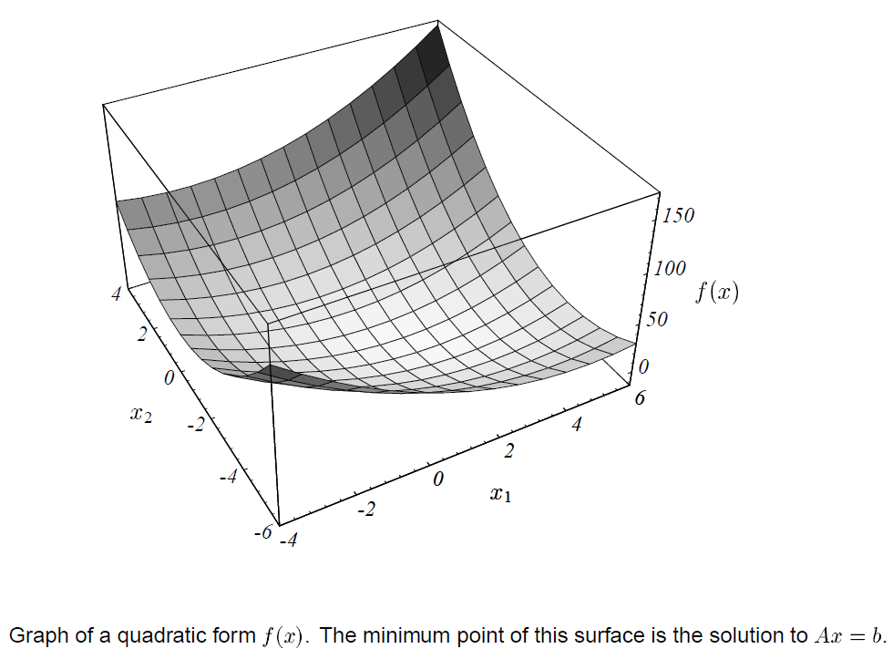

Quadratic form
Minimizing
$$f\left(x\right)=\frac{1}{2}x^{T}Ax−b^{T}x+c$$
Is equivalent to solving
$$Ax=b$$
Since
$$f^{′}\left(x\right)=Ax−b$$
Source : Jonathan Richard Shewchuk 1994 - An Introduction to the Conjugate Gradient Method Without the Agonizing Pain

Slide 4
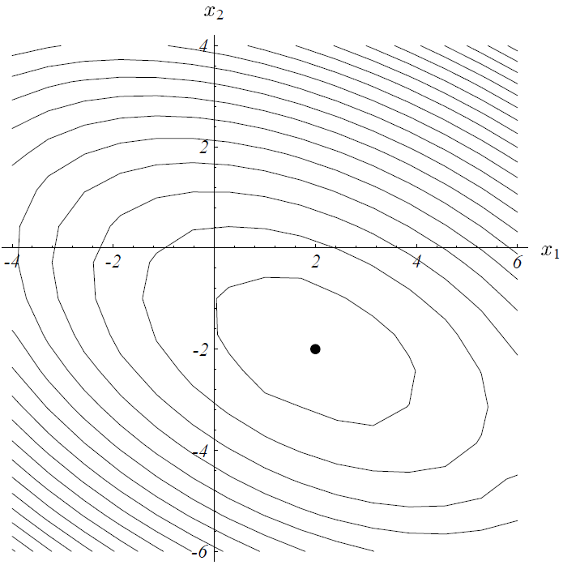
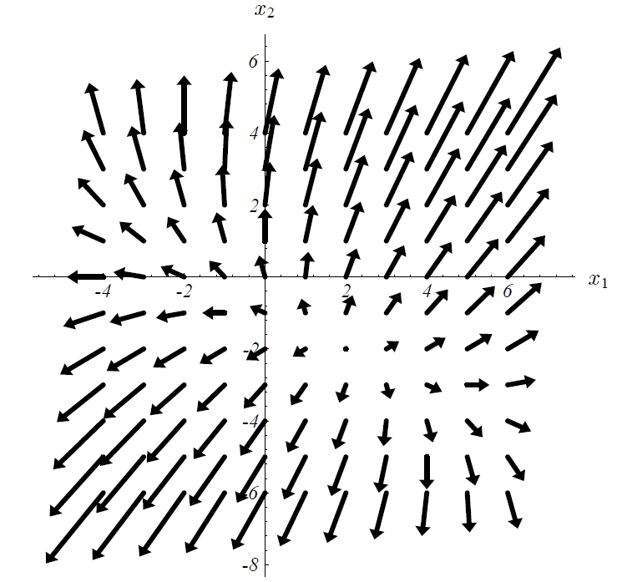
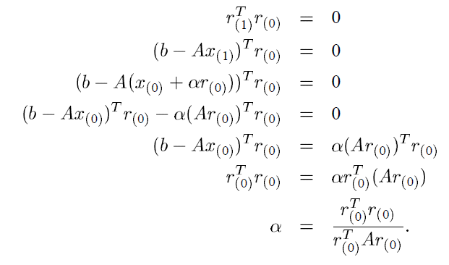


Method of Steepest Descent
Residual $r_{i}=b−Ax_{i}=−∇f(x)$
Take step along $−∇f\left(x\right)$
$$x_{i+1}=x_{i}+αr_{i}$$
Minimize $f\left(x\right)$ with a line search
$$α_{i}=\frac{r_{i}^{T}r_{i}}{r_{i}^{T}Ar_{i}}$$
$$∇f(x)$$
Source : Jonathan Richard Shewchuk 1994 - An Introduction to the Conjugate Gradient Method Without the Agonizing Pain

Slide 5
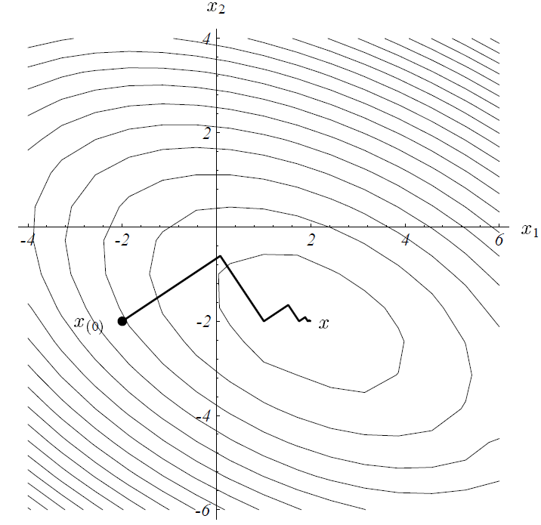
Can we do better?
Source : Jonathan Richard Shewchuk 1994 - An Introduction to the Conjugate Gradient Method Without the Agonizing Pain

Slide 6
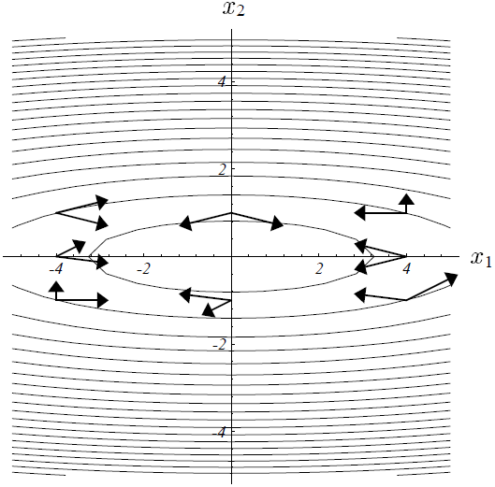
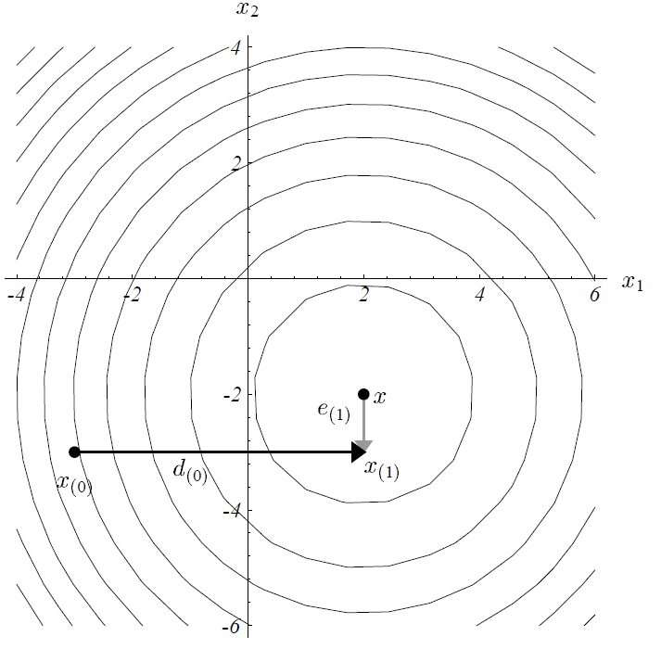
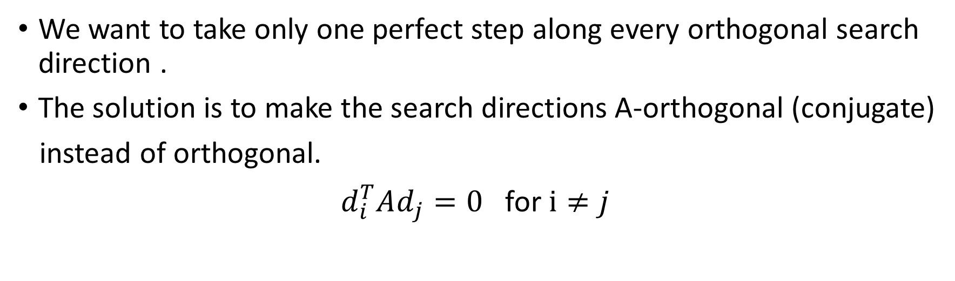
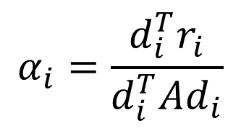
The Method of Conjugate Directions
We want to take only one perfect step along every orthogonal search direction .
The solution is to make the search directions A-orthogonal (conjugate)
instead of orthogonal.
$d_{i}^{T}Ad_{j}=0$ for $i≠j$
$$α_{i}=\frac{d_{i}^{T}r_{i}}{d_{i}^{T}Ad_{i}}$$
Source : Jonathan Richard Shewchuk 1994 - An Introduction to the Conjugate Gradient Method Without the Agonizing Pain
A-orthogonal directions

Slide 7
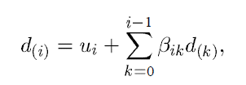
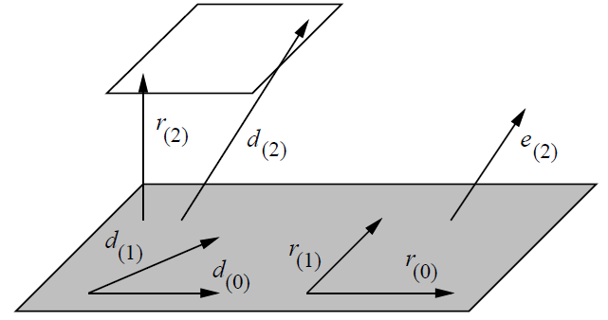
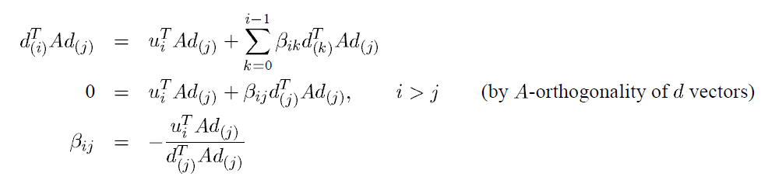
Find a set of A-orthogonal search directions
Source : Jonathan Richard Shewchuk 1994 - An Introduction to the Conjugate Gradient Method Without the Agonizing Pain

Slide 8

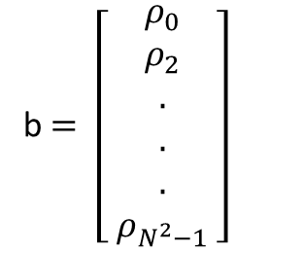
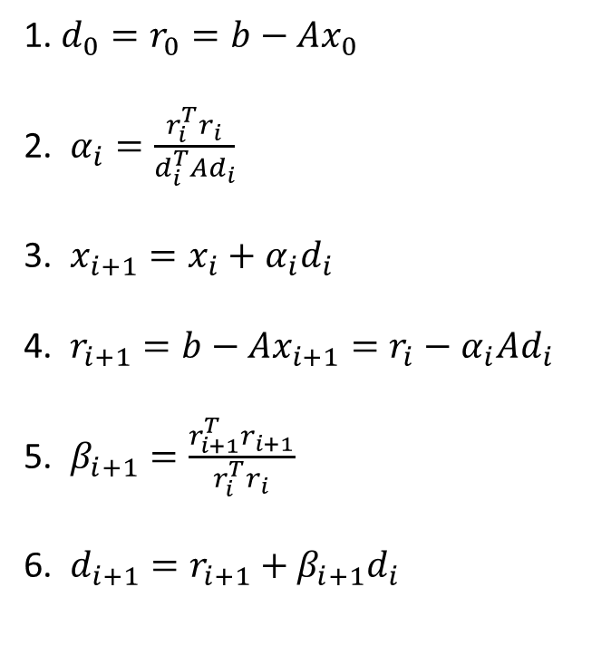
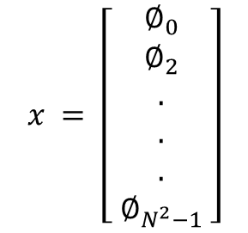

The Method of Conjugate Gradients
1. $d_{0}=r_{0}=b−Ax_{0}$
2. $α_{i}=\frac{r_{i}^{T}r_{i}}{d_{i}^{T}Ad_{i}}$
3. $x_{i+1}=x_{i}+α_{i}d_{i}$
4. $r_{i+1}=b−Ax_{i+1}=r_{i}−α_{i}Ad_{i}$
5. $β_{i+1}=\frac{r_{i+1}^{T}r_{i+1}}{r_{i}^{T}r_{i}}$
6. $d_{i+1}=r_{i+1}+β_{i+1}d_{i}$
For N*N Poisson problem
$∇^{2}∅=ρ$ ⬄
$$Ax=b$$
$$A=∇^{2}=\frac{(∅_{i−N}+∅_{i+N}+∅_{i+1}+∅_{i−1}−4∅_{i}) }{∆^{2}}$$
$$x = \left[ \begin{aligned}∅_{0} \\ ∅_{2} \\ . \\ . \\ . \\ ∅_{N^{2}−1}\end{aligned} \right]$$
b$= \left[ \begin{aligned}ρ_{0} \\ ρ_{2} \\ . \\ . \\ . \\ ρ_{N^{2}−1}\end{aligned} \right]$

Slide 9
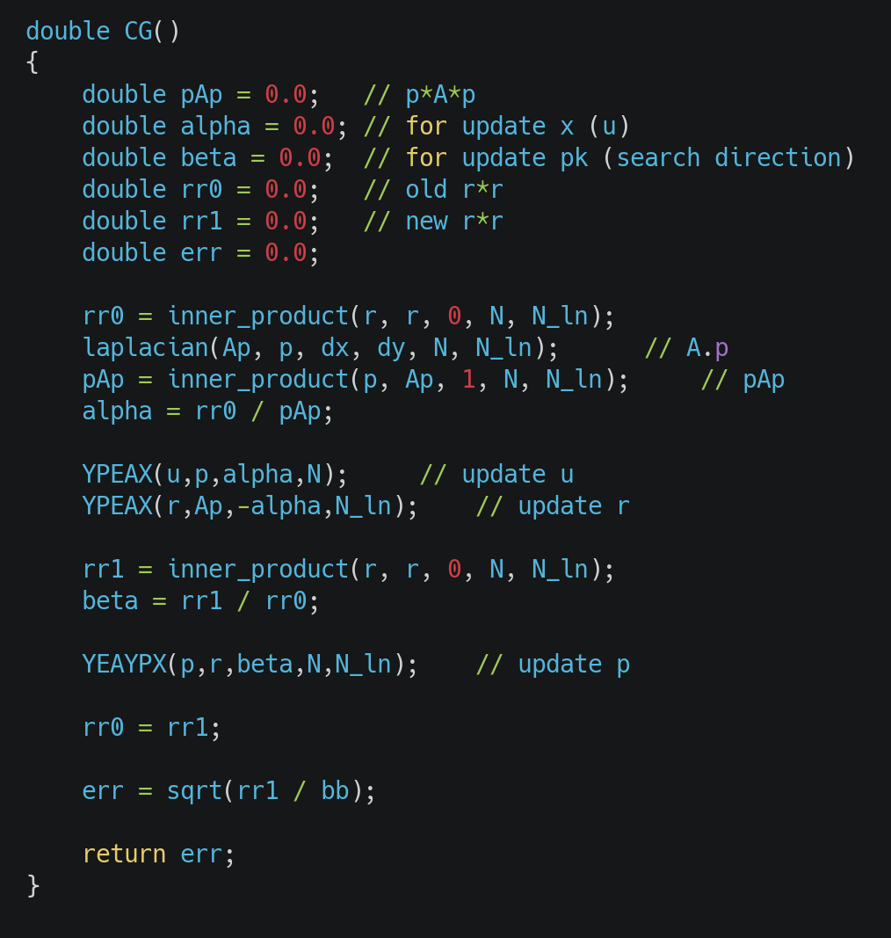
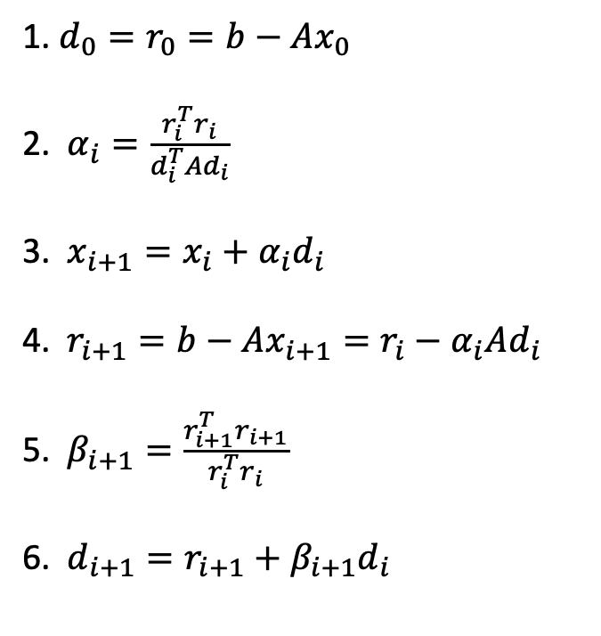
1. $d_{0}=r_{0}=b−Ax_{0}$
2. $α_{i}=\frac{r_{i}^{T}r_{i}}{d_{i}^{T}Ad_{i}}$
3. $x_{i+1}=x_{i}+α_{i}d_{i}$
4. $r_{i+1}=b−Ax_{i+1}=r_{i}−α_{i}Ad_{i}$
5. $β_{i+1}=\frac{r_{i+1}^{T}r_{i+1}}{r_{i}^{T}r_{i}}$
6. $d_{i+1}=r_{i+1}+β_{i+1}d_{i}$

Slide 10
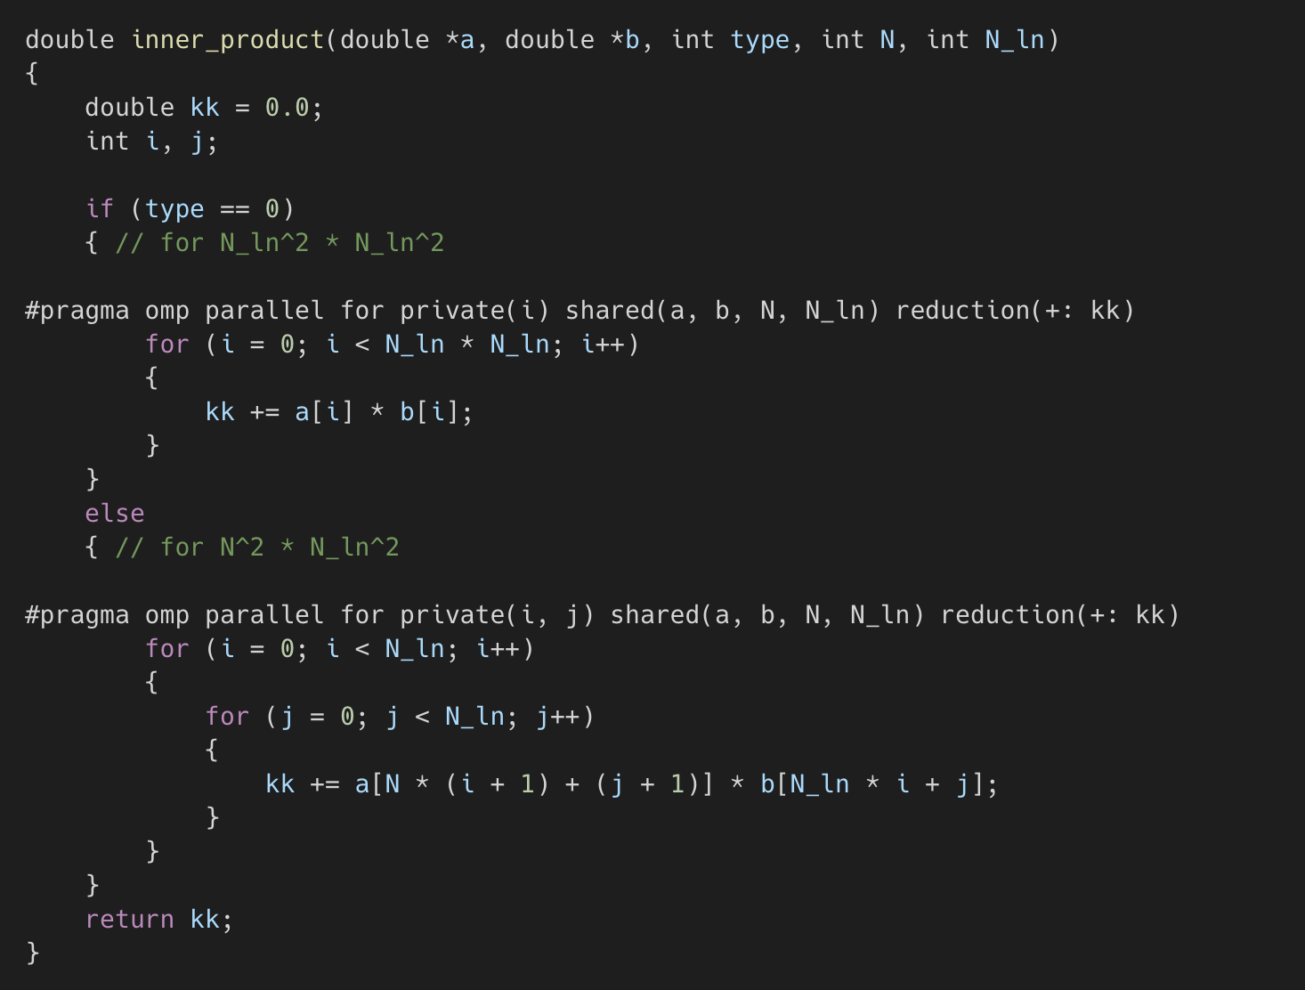

Slide 11
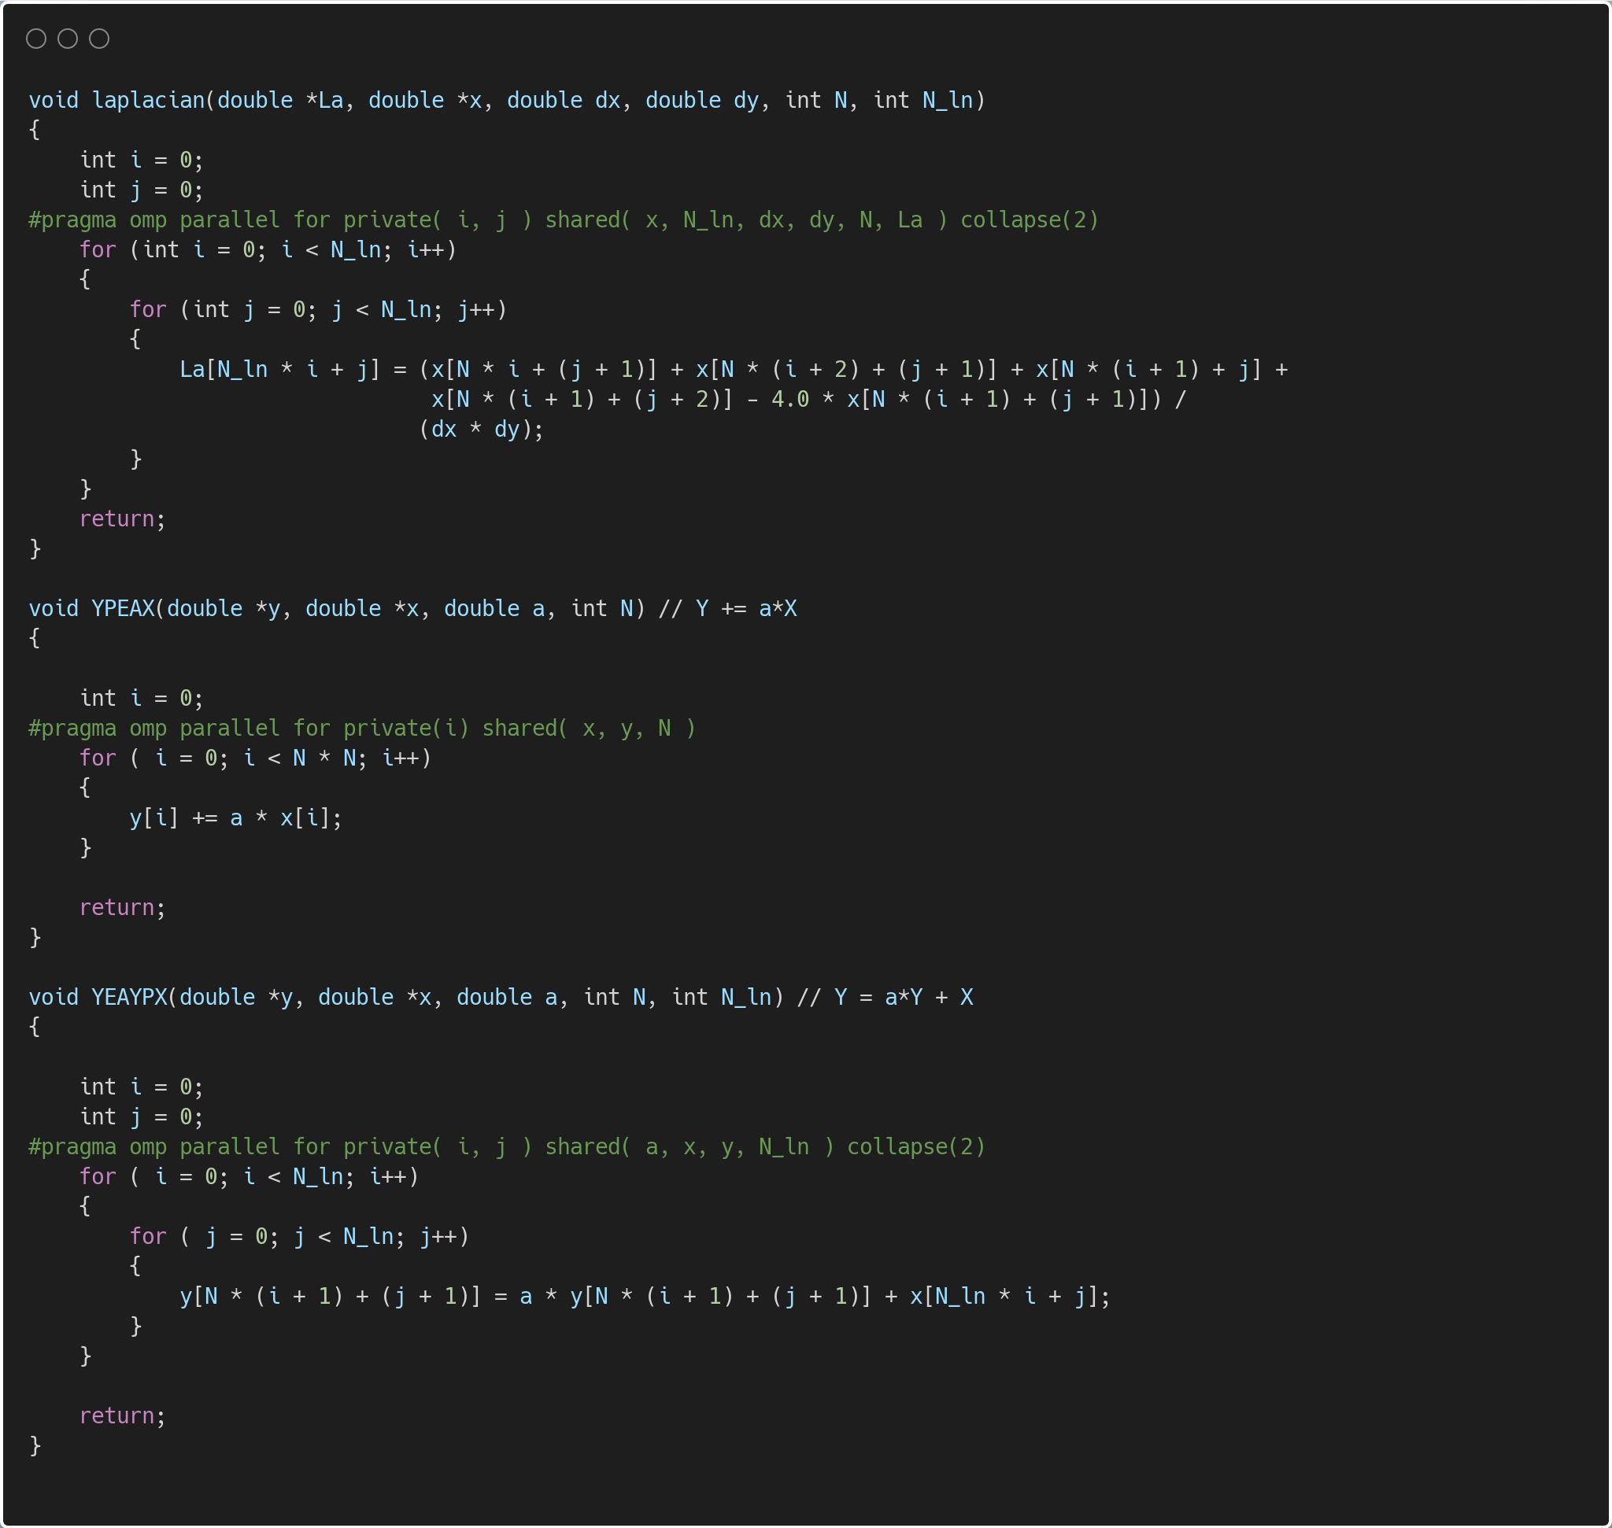

Slide 12
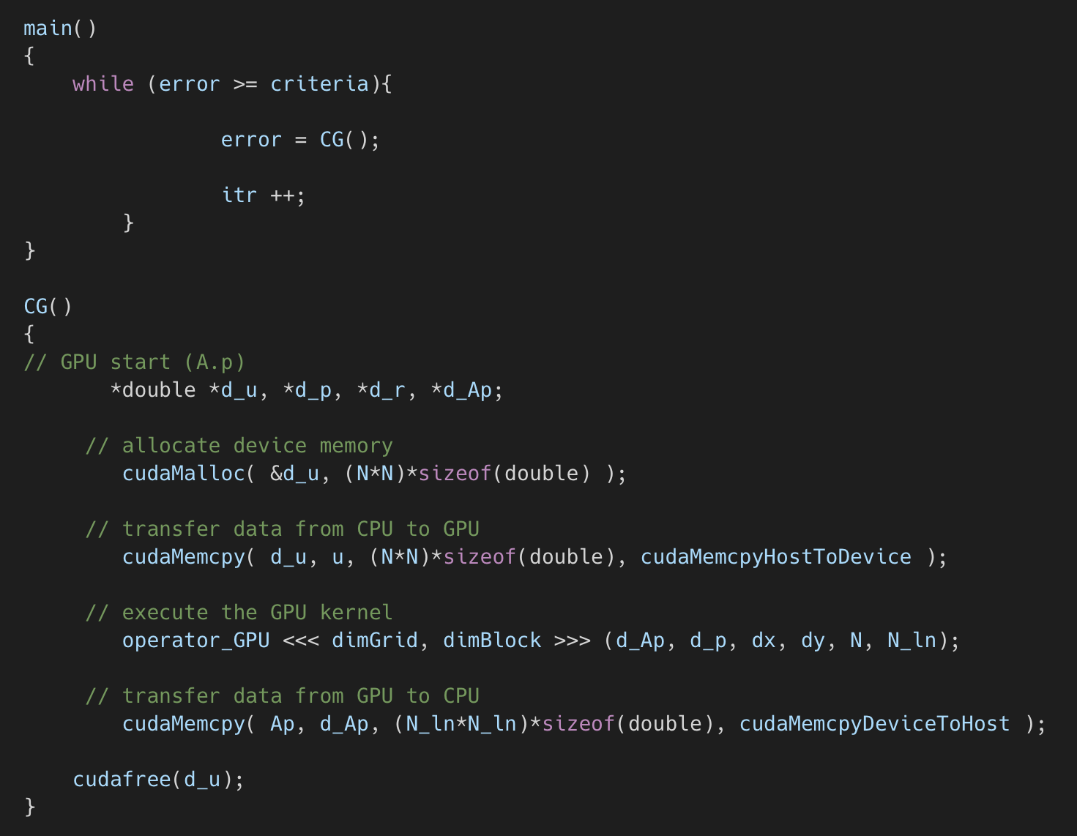

Slide 13
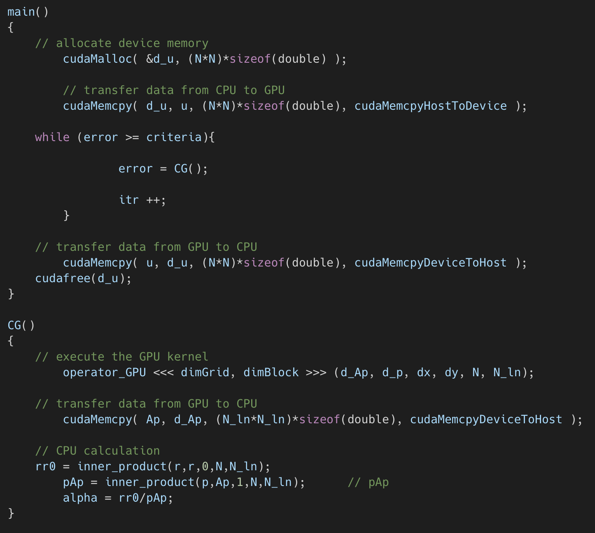

Slide 14
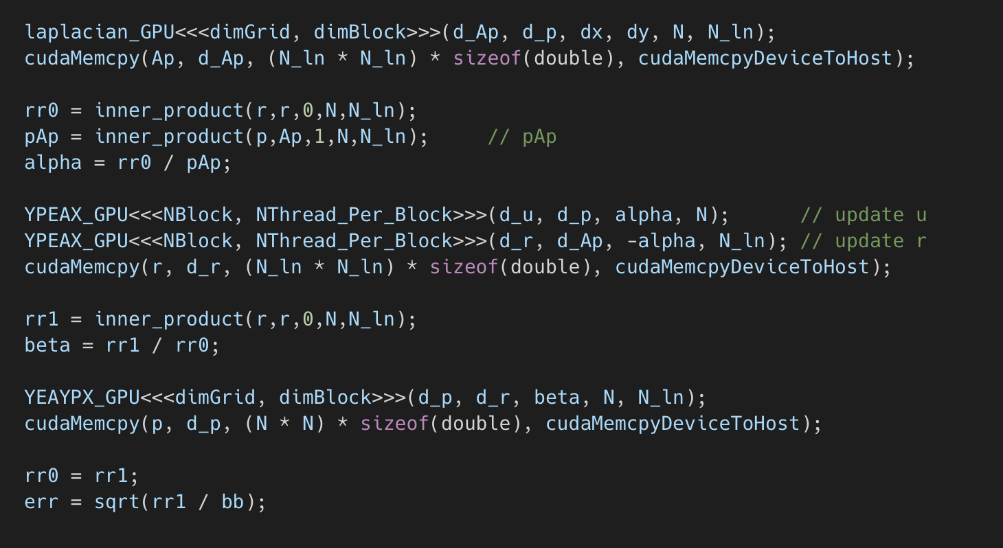

Slide 15
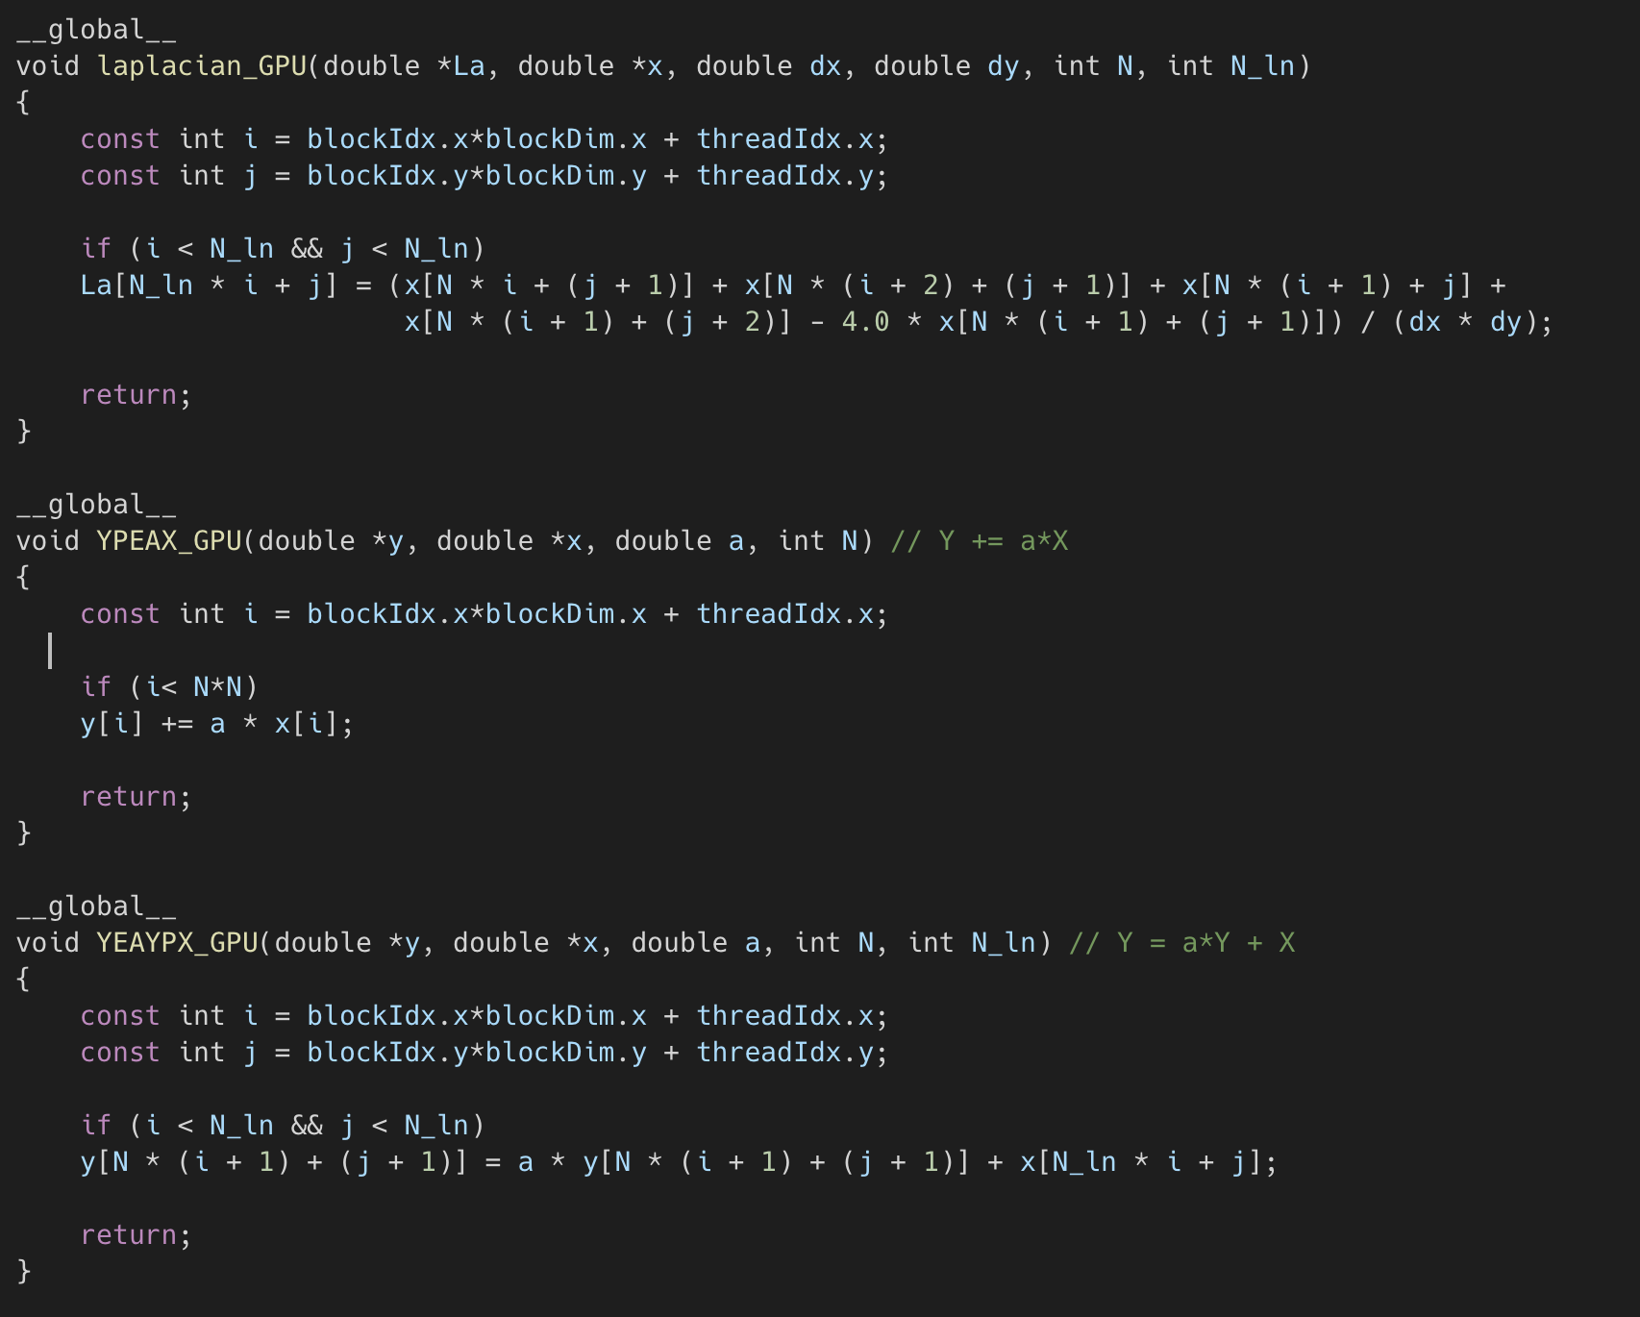

Slide 16
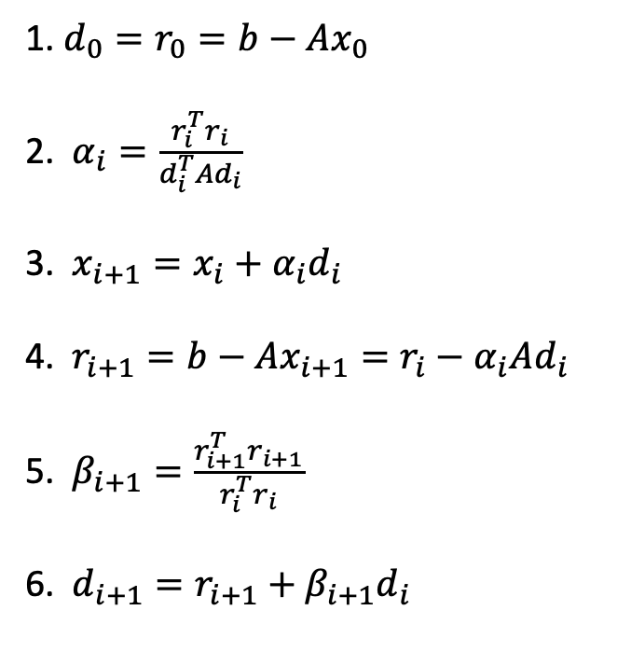
Algorithm Comparison
1. $d_{0}=r_{0}=b−Ax_{0}$
2. $α_{i}=\frac{r_{i}^{T}r_{i}}{d_{i}^{T}Ad_{i}}$
3. $x_{i+1}=x_{i}+α_{i}d_{i}$
4. $r_{i+1}=b−Ax_{i+1}=r_{i}−α_{i}Ad_{i}$
5. $β_{i+1}=\frac{r_{i+1}^{T}r_{i+1}}{r_{i}^{T}r_{i}}$
6. $d_{i+1}=r_{i+1}+β_{i+1}d_{i}$
Even Grid : $U_{i,j}^{m+1}=\frac{w}{4} ∗(U_{i−1,j}^{m}+U_{i+1,j}^{m}+U_{i,j−1}^{m}+U_{i,j+1}^{m}−4U_{i,j}^{m}+b_{i,j})$
Odd Grid : $U_{i,j}^{m+1}=\frac{w}{4} ∗(U_{i−1,j}^{m}+U_{i+1,j}^{m}+U_{i,j−1}^{m}+U_{i,j+1}^{m}−4U_{i,j}^{m}+b_{i,j})$

Slide 17
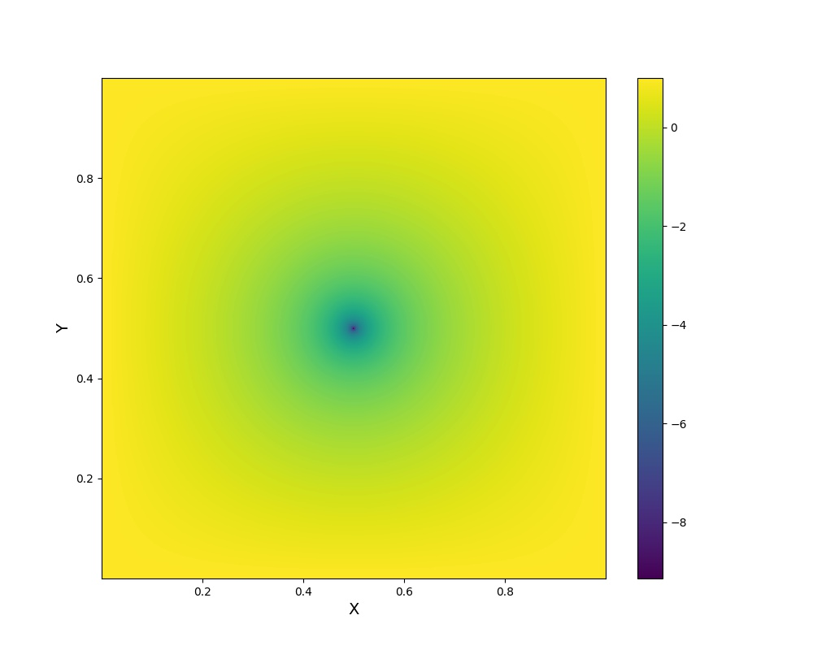
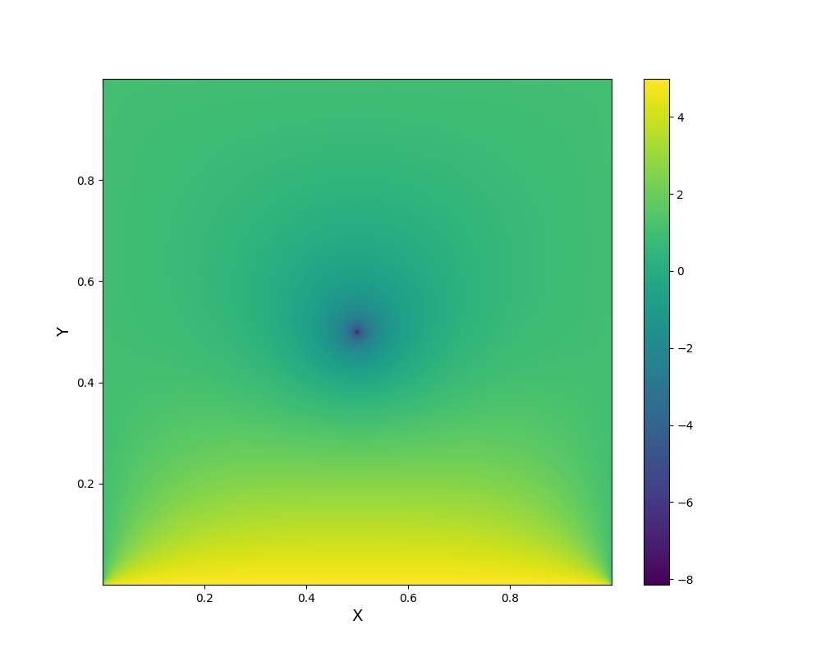
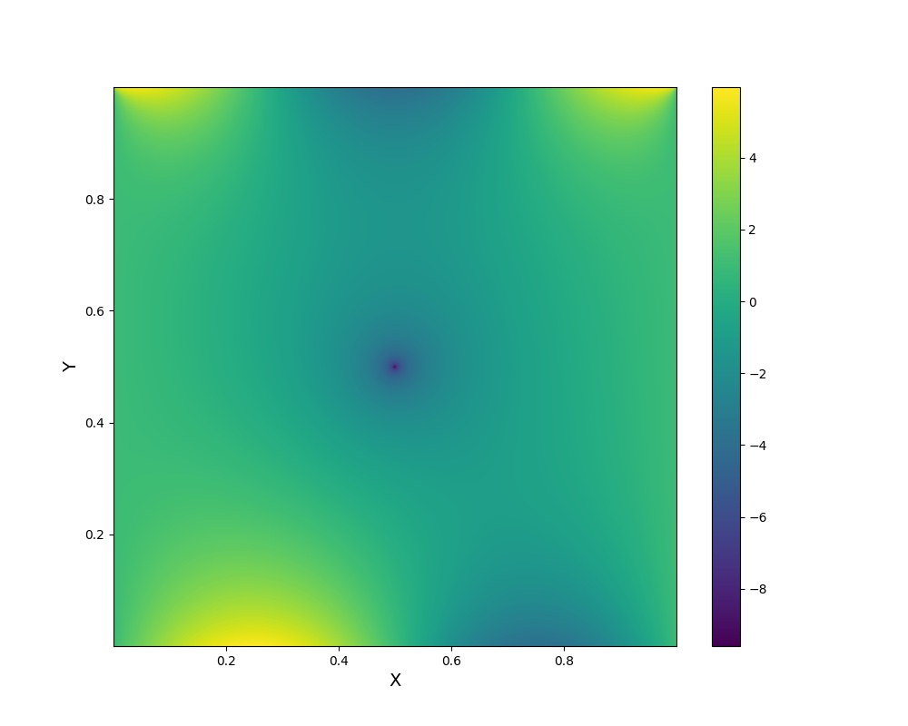
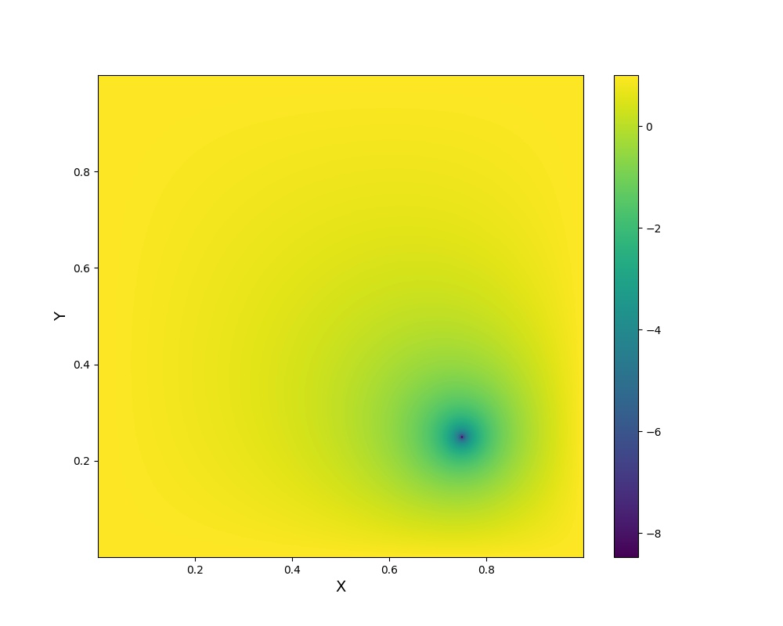
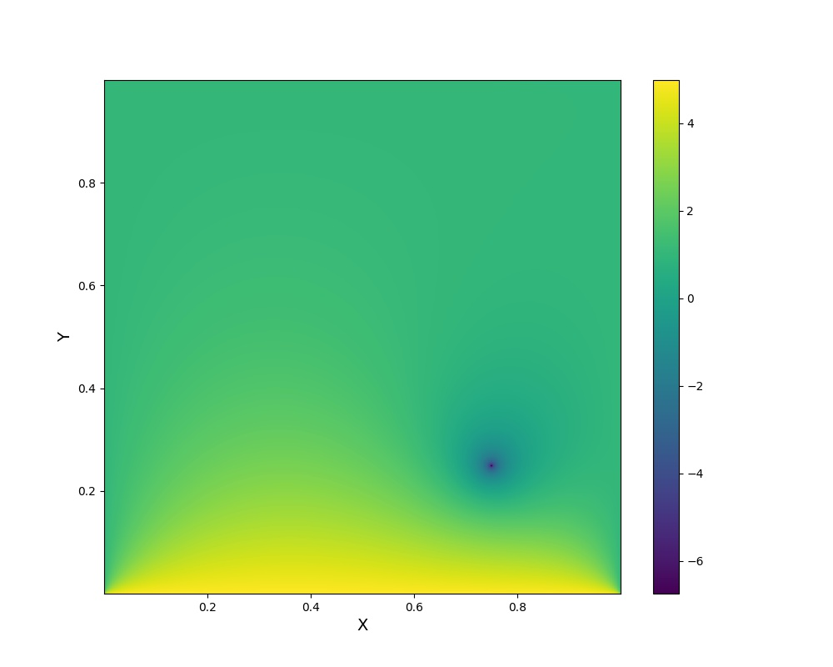
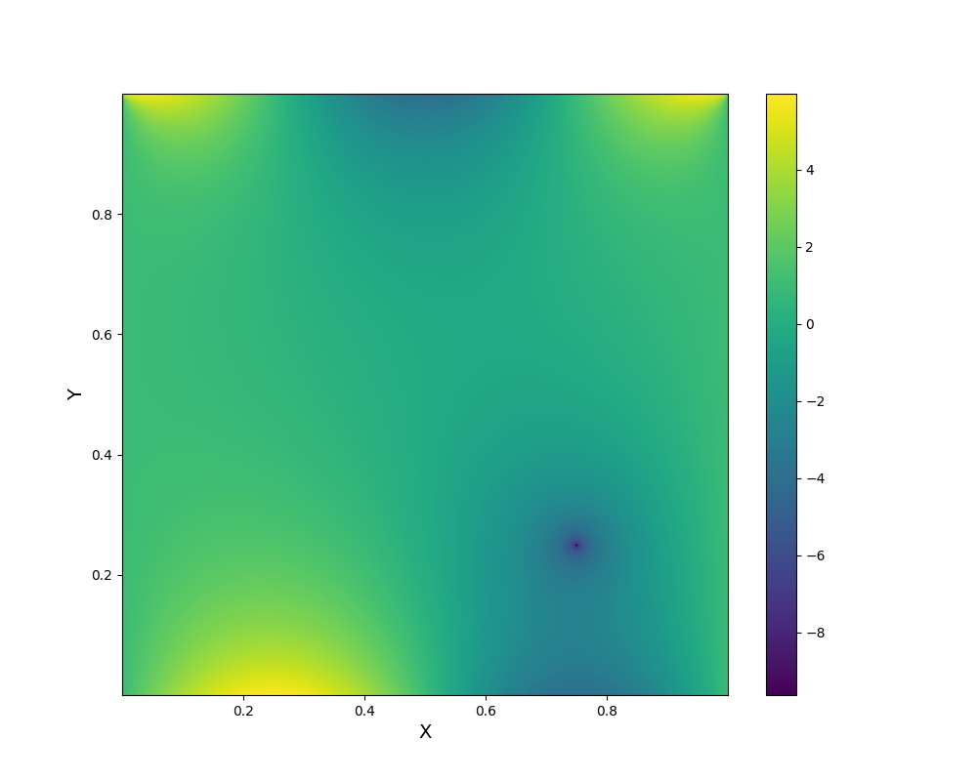
Const BC and Point Source
One Side BC and Point Source
Sin BC and Point Source
Const BC and 4th q Point Source
One Side BC and 4 th q Point Source
Sin BC and 4th q Point Source

Slide 18
Trend of Error Convergence

Slide 19

N v.s. iteration ( 8 threads )
 | N = 16 | N = 32 | N = 64 | N = 128 | N = 256 | N = 512 | N = 1024
SOR | 1089 | 1256 | 1427 | 1556 | 1706 | 1806 | 2314
CG | 35 | 79 | 160 | 319 | 627 | 1246 | 2665
Boundary Condition

Slide 20
Multi-Threads Performance Comparison
N = 1024 |  | 1 | 2 | 4 | 8
 | SOR | 15.553 | 8.403 | 4.666 | 4.990
 | SOR Speed up | 1 | 1.840 | 3.321 | 3.112
 | CG | 64.201 | 32.694 | 18.894 | 14.422
 | CG Speed up | 1 | 1.963 | 3.398 | 4.452
N = 512 |  | 1 | 2 | 4 | 8
 | SOR | 3.482 | 2.028 | 1.230 | 1.363
 | SOR Speed up | 1 | 1.713 | 2.830 | 2.550
 | CG | 10.681 | 5.732 | 3.091 | 2.658
 | CG Speed up | 1 | 1.863 | 3.456 | 4.018

Slide 21
Multi-Threads Performance Comparison
N = 256 |  | 1 | 2 | 4 | 8
 | SOR | 0.859 | 0.552 | 0.434 | 0.434
 | SOR Speed Up | 1 | 1.556 | 1.979 | 1.979
 | CG | 2.490 | 1.402 | 0.867 | 0.737
 | CG Speed Up | 1 | 1.776 | 2.879 | 3.379
N = 128 |  | 1 | 2 | 4 | 8
 | SOR | 0.217 | 0.193 | 0.178 | 0.200
 | SOR Speed Up | 1 | 1.124 | 1.219 | 1.085
 | CG | 0.966 | 0.567 | 0.348 | 0.310
 | CG Speed Up | 1 | 1.704 | 2.776 | 3.116

Slide 22
GPU Performance Comparison
CG | N = 64 | N = 128 | N = 256 | N = 512 | N = 1024
 | 0.02 | 0.08 | 0.54 | 3.96 | 29.31
Machine : Eureka
# : Inner product without GPU

Slide 23
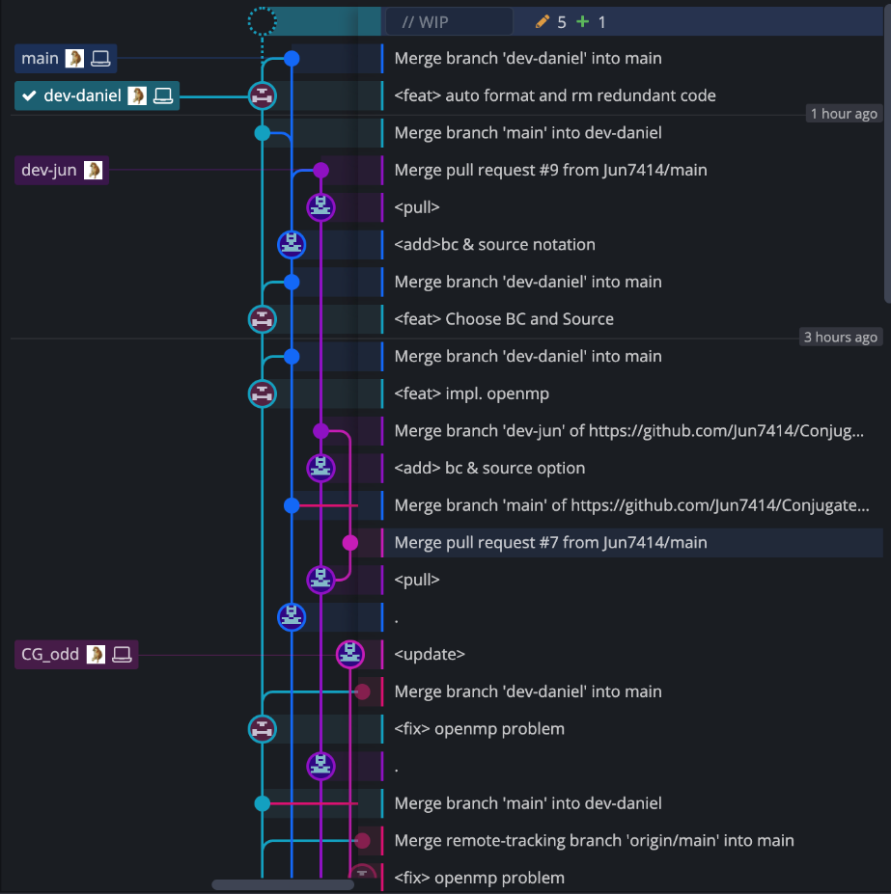
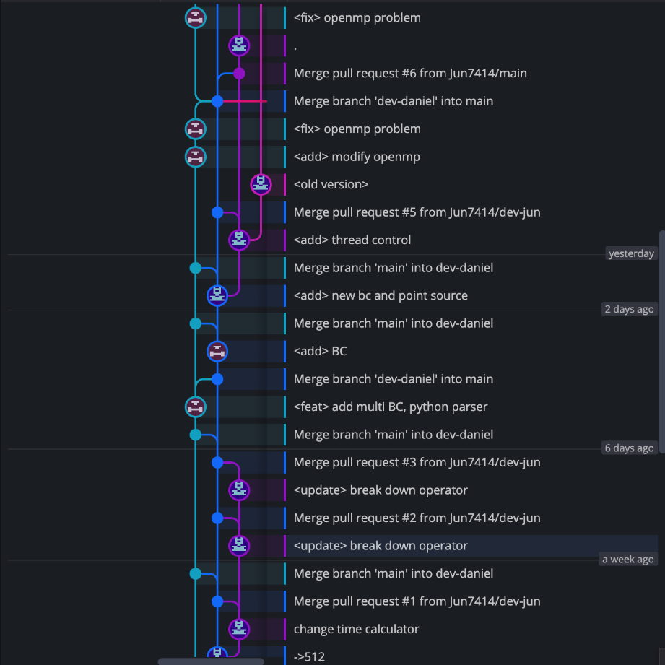

Our Github Workflow
https://github.com/Jun7414/Conjugate-Gradient-Poisson-Solver

